Slide 1
The Advisor board
De Yu

Slide 2
Overview
For Potential Grad Students
Search Advisor
By professor name, university, topics

Slide 3
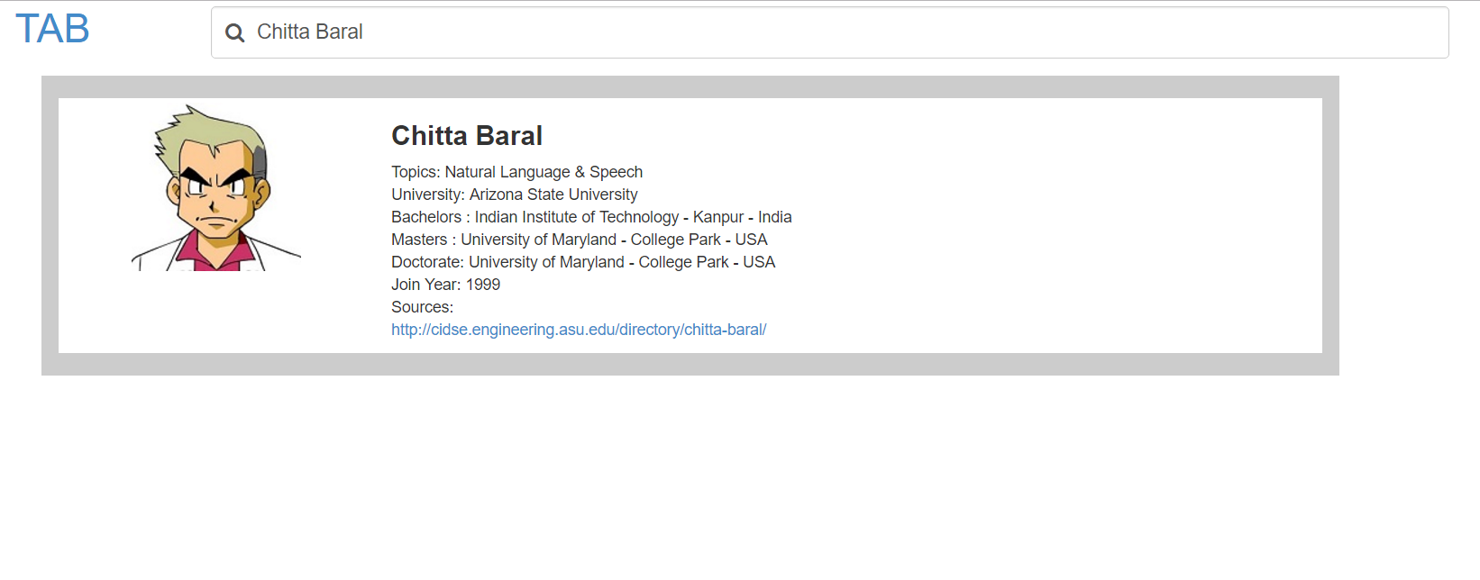
Implementation
Database: Mongodb
Server: Nodejs
FrontEnd:
Angularjs
HTML
CSS/JS

Slide 4
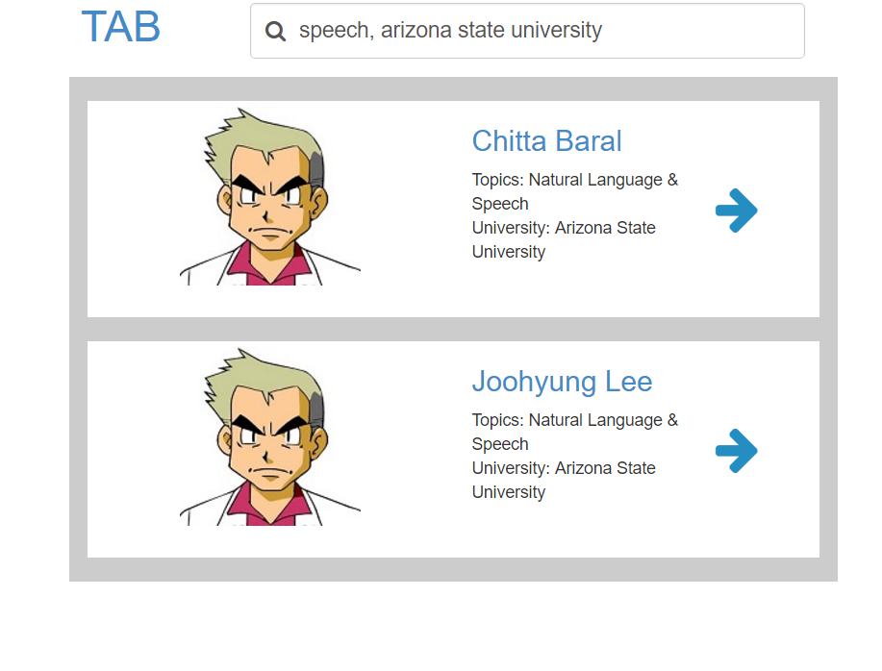
conclusion
Real world
Database
Search Multiple terms

